Slide 1
Memory

Slide 2
About this lecture..
In this lecture, we will study
Concepts of primary memory.
Different types of primary memory
Random access memory (RAM)
Read only memory (ROM).
Different types of RAM
Static RAM (SRAM)
Dynamic RAM (DRAM).
DRAM organization.
Design of memory subsystem using SRAM.
Design of memory subsystem using DRAM.

Slide 3
Technologies
Writeable vs. non-writeable
ROM (Read only memory)
RAM (Read write memory but known as Random Access memory)
Volatility
Does memory retain values when powered off?
ROM, NVRAM
Technology
ROM: Data masked at fabrication time
PROM: Once programmable (specialized programmers)
EPROM: Erasable and then programmable
EEPROM: Electrically (selectively) erasable
Flash: Sector oriented
RAM, Static vs. Dynamic
Dynamic: Slow but cheap. DRAM, EDORAM (Extended Data Out RAM), S(Single)DRAM, DDR(Double Data Rate)-RAM

Slide 4
Memory
Primary Memory keeps data and programs for execution by a computer.
Execution time depends on the program and data transfer time to and from the primary memory.
A computer generates K bit wide address for the memory.
Thus there will be 2^{K} distinct locations.

Slide 5
Memory
CPU generates address under a program control and puts them in an internal register called MAR.
MAR register output is available on the external pins of the CPU chip.
Similarly, MDR register of the processor is used to transfer data between primary memory and CPU.
Data transfer to and from memory is done using a bus known as Memory Bus.
Memory bus consists of three types of lines.
Address lines
Data lines
Control lines

Slide 6
Memory
Word-addressable Machine
A word is the memory data of size N bits.
In some computers, word is the smallest and the only addressable unit.
Words are addressed starting from 0.
Byte-addressable Machine
In some computers, Byte is the smallest addressable unit. A word consists of one byte (8 bits) for 8 bit computers, 2 bytes for 16 bit computers, 4 bytes for 32 bit computers and 8 bytes for 64 bit computers.
Bytes are addressed starting from 0.

Slide 7
Memory
Word length is the maximum number of bits that can be stored or retrieved in a single memory access.
Accessing a particular byte is done either to read or write on to the byte location. In a byte addressable system,
Read operation fetches only the desired byte.
Write operation changes the content of only the desired byte without disturbing the other bytes in the word.

Slide 8
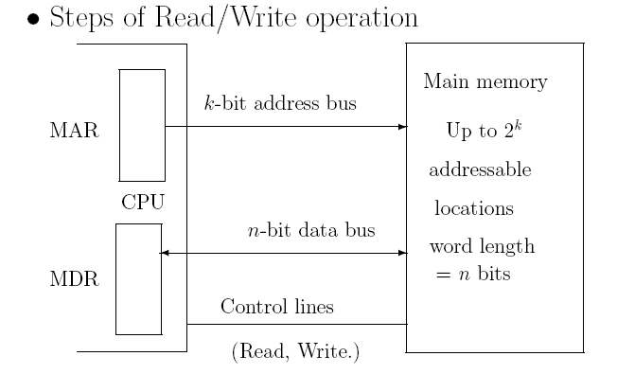
Memory
Memory Access Time: Time required to read the memory after placing a request.
Memory Cycle Time: Time required between two successive memory requests.

Slide 9
Types of Primary Memory
ROM– Read Only Memory
RAM– Random Access Memory

Slide 10
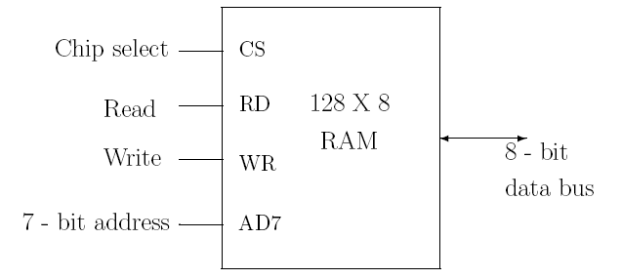
Random Access Memory
Random Access Memory (RAM) is a memory unit where data from any memory location can be read or written in a constant amount of time.
The following is the block diagram for such a memory.

Slide 11
Memory addressability
Memory is a big array of bytes
Not entire address space need to have storage attached.
Processors need to read multi-byte data structures
Short (2 bytes), int (4 bytes), double (8 bytes) etc.
Should the access be one byte at a time?
Issue of the bus interface

Slide 12
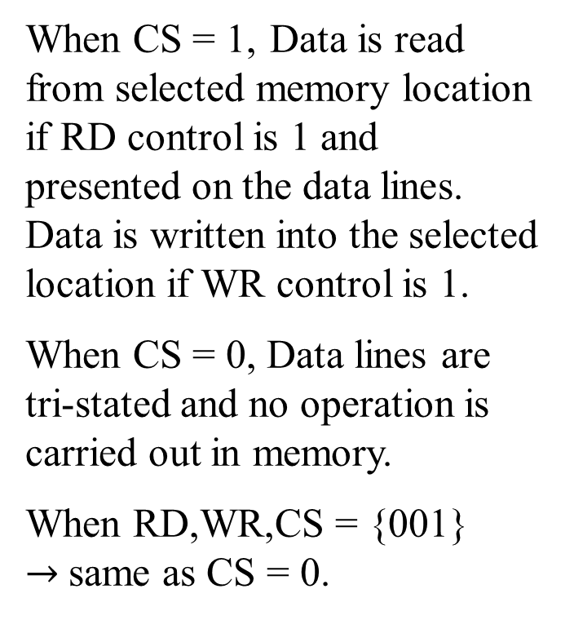
Memory Interface: Simple byte wide bus
When CS = 1, Data is read from selected memory location if RD control is 1 and presented on the data lines. Data is written into the selected location if WR control is 1.
When CS = 0, Data lines are tri-stated and no operation is carried out in memory.
When RD,WR,CS = {001} $→$same as CS = 0.
2^{n} locations
n-bit address
8-bit data
CS Control
RD, WR Controls

Slide 13
Random Access Memory
Static RAM
Dynamic RAM (DRAM)

Slide 14
RAM
Static RAM
Consists of memory elements such as flip-flops for storing binary information.
Keeps the stored information as long as power is available in the unit.
Dynamic RAM
Information is stored in the form of electric charge applied to the capacitors.
Information is available for short duration.
To retain for longer period, cell is to be refreshed periodically.

Slide 15
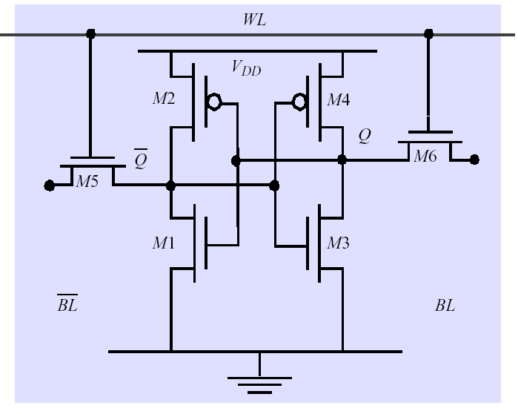
Static RAM (SRAM)
Six transistors in cross connected fashion
Provides regular AND inverted outputs
Implemented in CMOS process
Single Port 6-T SRAM Cell

Slide 16
Dynamic RAM
SRAM cells exhibit high speed/poor density
DRAM: simple transistor/capacitor pairs in high density form
Word Line
C
. . .
Bit Line
Sense Amp

Slide 17
DRAM Operations
Write
Charge bitline HIGH or LOW and set wordline HIGH
Read
Bit line is precharged to a voltage halfway between HIGH and LOW, and then the word line is set HIGH.
Depending on the charge in the cap, the precharged bitline is pulled slightly higher or lower.
Sense Amp Detects change
Explains why Cap can’t shrink
Need to sufficiently drive bitline
Increase density => increase parasitic capacitance
Word Line
C
. . .
Bit Line
Sense Amp

Slide 18
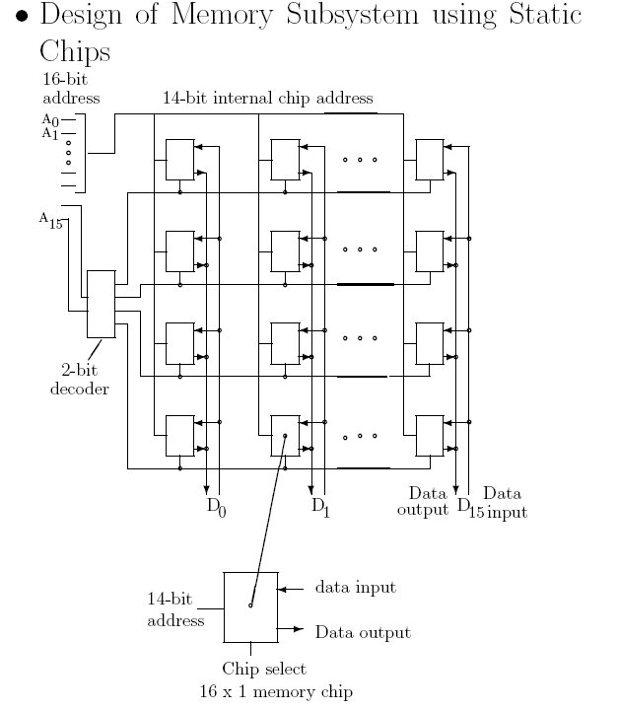
Memory

Slide 19
Dynamic Memory
Some Comments on Dynamic Memories (DRAM)
Dynamic memories are less costly and high density.
Chips are available in different sizes.
A block of successive addresses in a row can be transferred in almost half of the time.

Slide 20
Dynamic Memory based Subsystem
Design of Memory Subsystem using Dynamic Chips
Design differs from that using static chips in three aspects.
Row and column address of each chip are multiplexed.
Use of refresh circuit for refreshing cells.
The need of controlling the timing of various steps of a cycle.

Slide 21
Dynamic Memory based Subsystem
An example of Memory Subsystem using Dynamic Chips
Consider an organization of a 64 DRAM chips based memory subsystem.
Each chip is 64K × 1 organization.
Chips are in array form.
Chips are arranged in 4 rows of 16 chips each.
Thus a 256K × 16 organization is obtained.
Memory bus has 18 address lines, 16 data lines and other control lines.

Slide 22
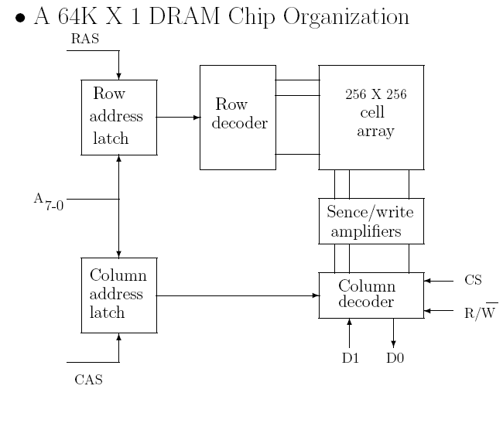
DRAM Organization

Slide 23
Memory
Some Comments on Refreshing Circuits
Helps in retaining Information
Does not affect other operations
Gets high priority
Refresh is usually done using refresh counter which provides row addresses for the refresh.
Counter counts from 0 to N −1 for N rows.
Refresh usually occurs in the background mode, i.e., when the processor is not using the memory.

Slide 24
Bus Switch
The bus switch design will be based on
BusAddress[1:0] and Size.
Most systems will have a switch and a wrapper like the one described.

Slide 25
Multi-byte wide Organization
Total Size: 2^{n+1} bytes
Address needed from the processor: n+1 bits
Each memory requires just n bits of address.
Wrapper on this organization of memory to provide
8-bit transfers
16-bit transfers
n-bit address
8-bit data
Block A
2^{n} byte
CS Control
RD, WR Controls
n-bit address
8-bit data
Block B
2^{n} byte
CS Control
RD, WR Controls

Slide 26
Wrapper
n+1 bit address
n bit address A
AddressA = AddressB = Address[n:1]
(0th bit of address is not used)
Size = 0: 8-bit transfer.
Size = 1: 16-bit transfer
if Size = 1 and Address[0] = 1 → Error
CSA = 1 if CS = 1 and Address[0] = 0.
RDA = RD if Address[0] = 0; 0 otherwise
WRA = WR if Address[0] = 0; 0 otherwise
CSB = CS if Address[0] = 1 or Size = 1
RDB = RD if address[0] = 1 or Size = 1
WRB = WR if address[0] = 1 or size = 1
Wrapper
CSA
CS
RDA
RD
WRA
WR
n bit address B
Size
CSB
Error
RDB
WRB
Data (16 bits)
Data (8-bit) A
Data (8-bit) B

